Slide 1

Terrain Generation: A Very Brief Overview
CS 418: Interactive Computer Graphics
UNIVERSITY OF ILLINOIS AT URBANA-CHAMPAIGN
Eric Shaffer

Slide 2
Procedural Modeling of Terrain
Lots of scenes require geometric models of natural objects
Clouds, Water, Plants, Terrain
Those last two items are often modeled using fractal techniques
Allows for the procedural generation of highly detailed models
We’ll look at a simple fractal modeling technique for terrain
Diamond-Square Algorithm
Developed by Loren Carpenter in 1980(ish)

Slide 3
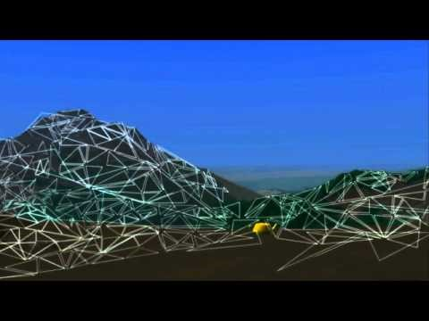
Loren Carpenter
Born in 1947
Co-founder and chief scientist at Pixar
One of the designers of Reyes
One of the authors of RenderMan
Invented A-Buffer hidden surface algorithm
Improved Mersenne Twistor RNG (2006)
Retired in 2014

Slide 4
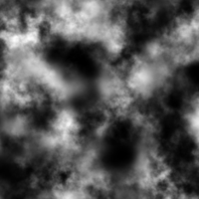
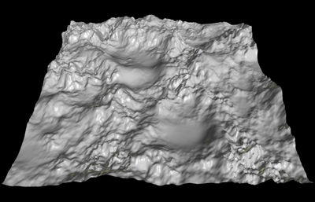
Height Maps
Rest of the scientific world uses Z for height…only computer graphics seems to prefer Y.
A height map is a simple data structure
For each point (X,Y) in a 2D domain
Describes a height or Z value
The (X,Y) points are usually discretely sampled
Typically in a uniform grid
Images are often used to store height maps
Stored terrain rather than generated
What phenomenon cannot be modeled this way?

Slide 5
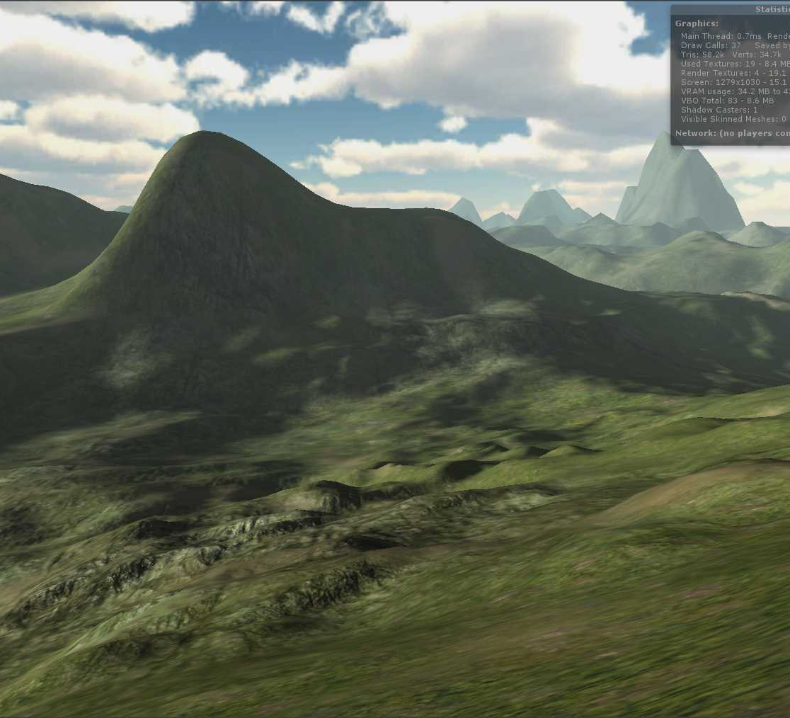
Generating a Terrain
Lots of different methods
Midpoint Displacement
Perlin noise
Diamond Square
Methods in industry
Usually involve some manual input
Simulate more stuff (e.g. erosion)
But often based on the above methods

Slide 6
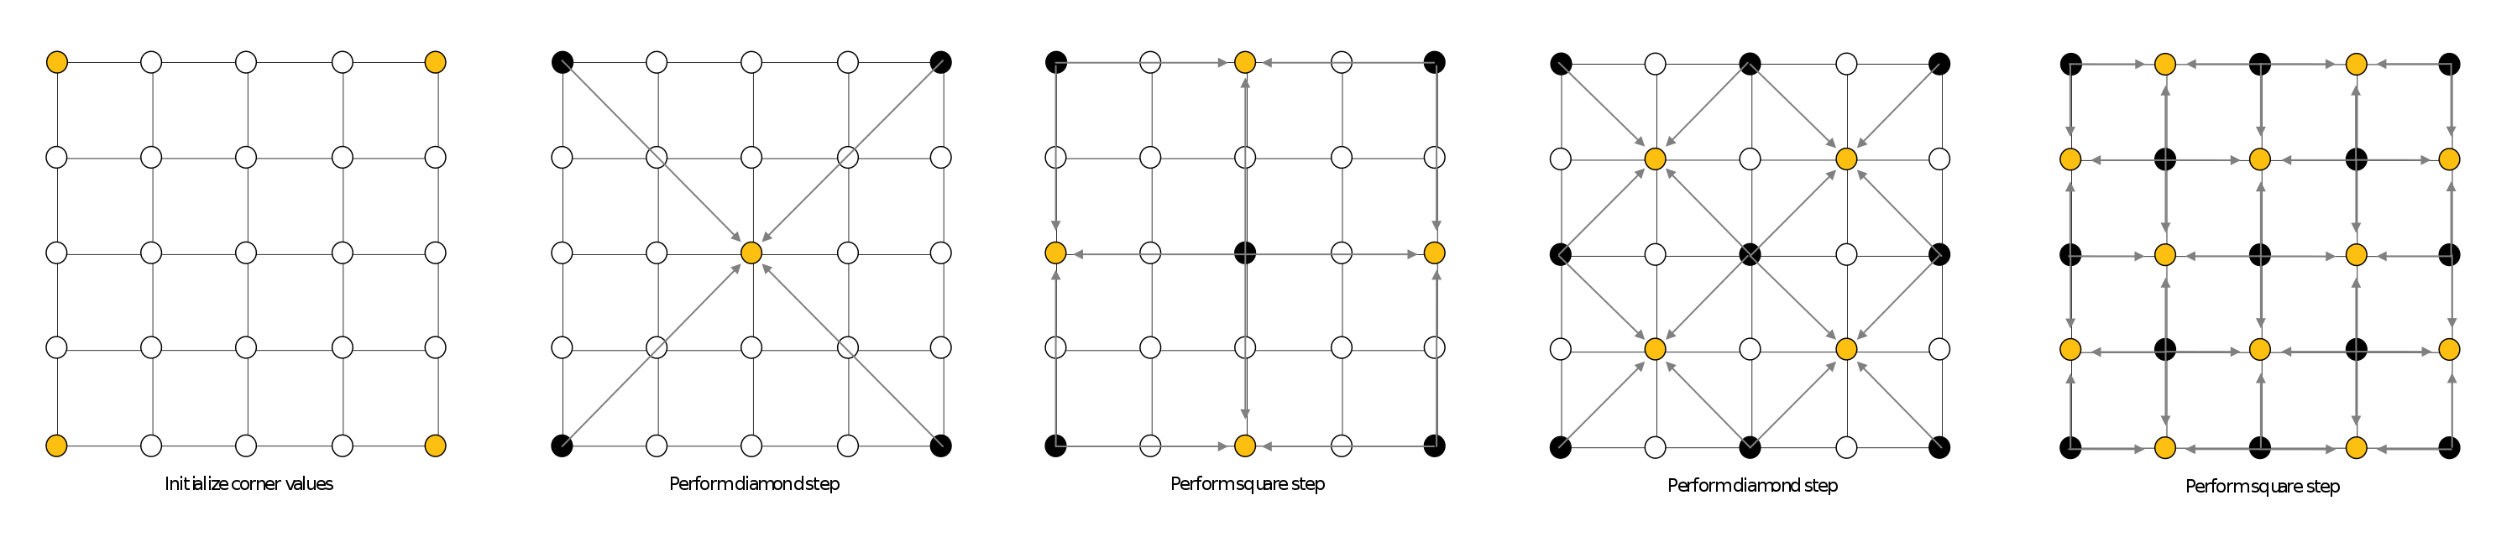
Diamond Square Algorithm
For now, we will focus only on the Diamond-Square algorithm
Basic idea:
https://en.wikipedia.org/wiki/Diamond-square_algorithm

Slide 7
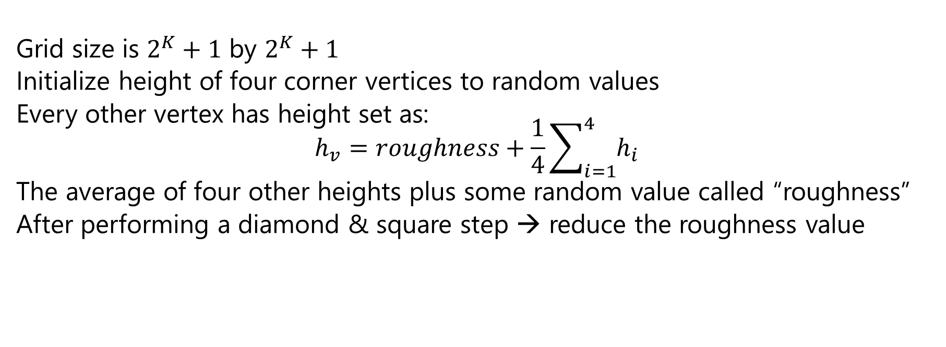
Diamond Square Algorithm
Grid size is $2^{K}+1$ by $2^{K}+1$
Initialize height of four corner vertices to random values
Every other vertex has height set as: $$h_{v}=roughness+\frac{1}{4}\sum_{i=1}^{4}{h_{i}}$$
The average of four other heights plus some random value called “roughness”
After performing a diamond & square step → reduce the roughness value

Slide 8
Diamond Square Algorithm
Parameters
K (grid size)
Roughness
Reduction (e.g. reduce roughness by ½ each iteration)
Can implement recursively or iteratively
I think recursion is harder….guesses as to why?
But recursion is doable…so do it if you want to…

Slide 9
Diamond Square: Implementation
Be careful about choosing k too big
Total number of vertices has to fit in 32 bits
Start by testing with 5x5
If you use the Lab code, make sure you understand the (i,j) indexing
i is row
j is column of the grid
Bottom left corner is (0,0)
Need to handle boundary cases
e.g. when there are only 3 neighbors
Option 1: use only 3 neighbors
Option 2: use a periodic boundary

Slide 10
Diamond Square: Implementation
For an iterative implementation one approach is
Consider an outer loop and two inner nested loops
Outer loop changes the radius of neighborhoods used for averages
For example, in the first diamond step below the radius is 4 steps, in the second it is 2 steps
How many iterations of the outer loop will there be?
Inner 2 nested loops iterate over the grid generating the (i,j) coordinates of vertices
One nested loop does diamond
One nested loop does square
Step size is set to generate only the indices needed for each step
For example first diamond is (2,2) and first square is (0,2) , (2,0) , (2,4) , (4,2)

Slide 11
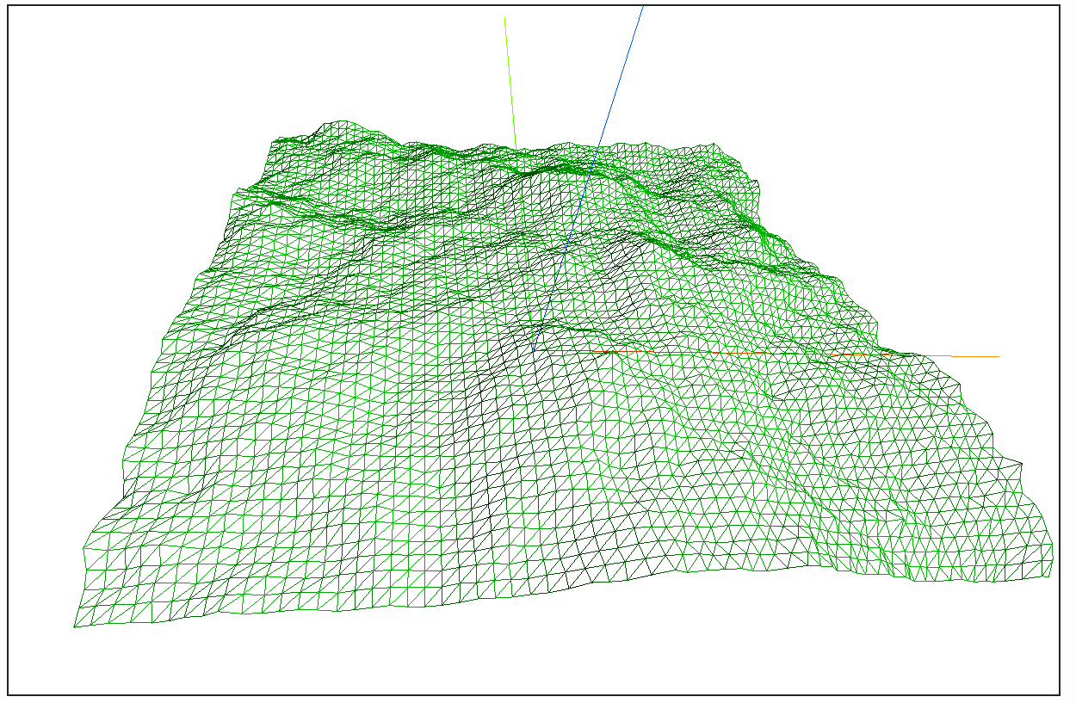
Diamond Square – Example Output

Slide 12
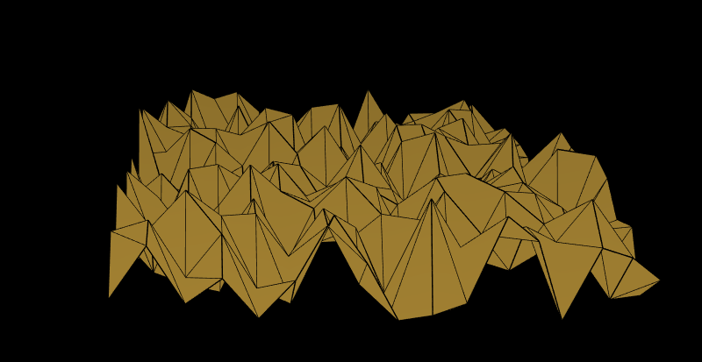
Example: Randomized Terrain (not acceptable)
What other problems are there?

